Slide 1
Voronoi Diagram & A Method for Creating Mosaic Images
Tianle Yuan

Slide 2
Catagory
Background
Introduction of the theory
Mosaic method

Slide 3
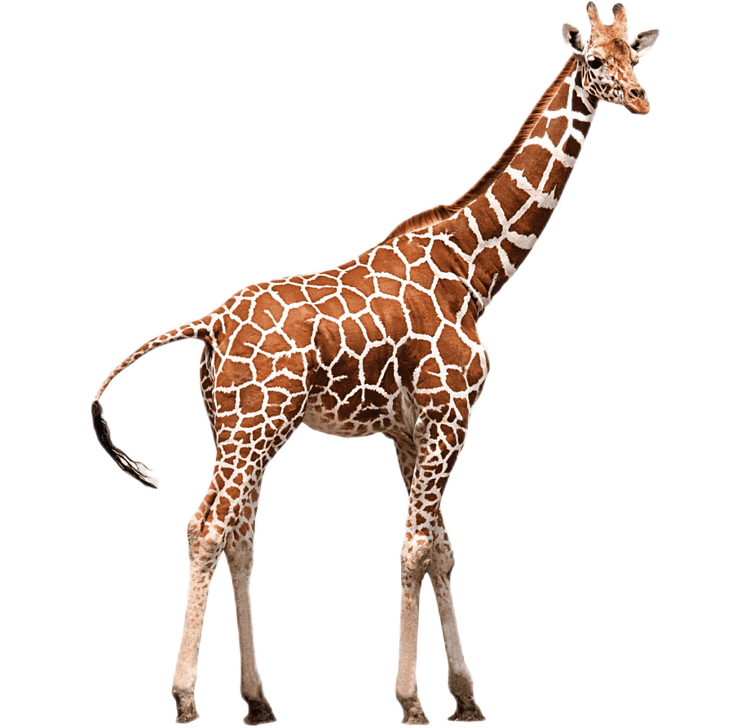

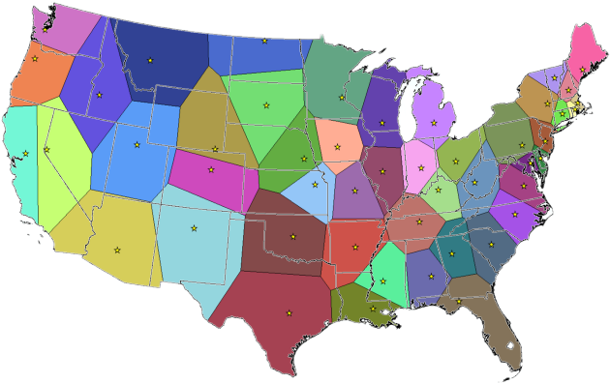
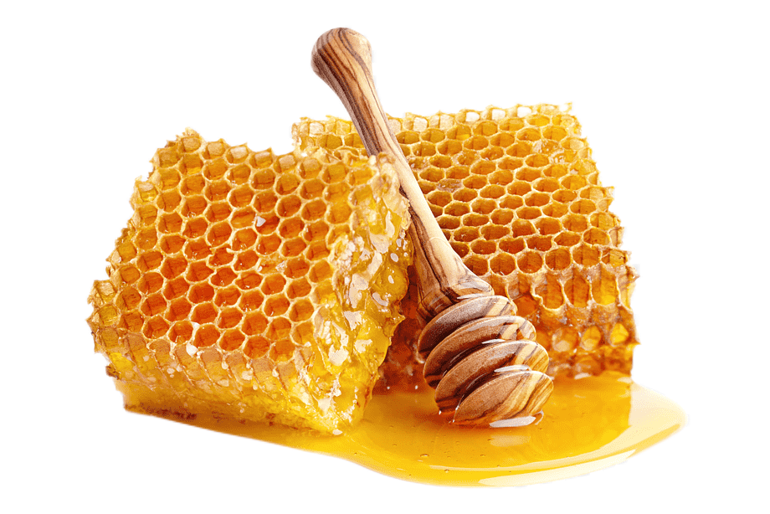
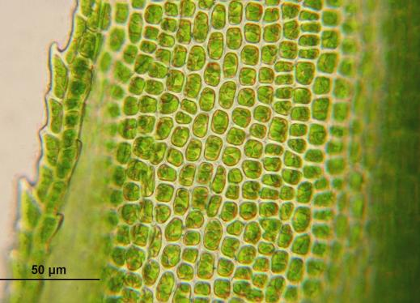
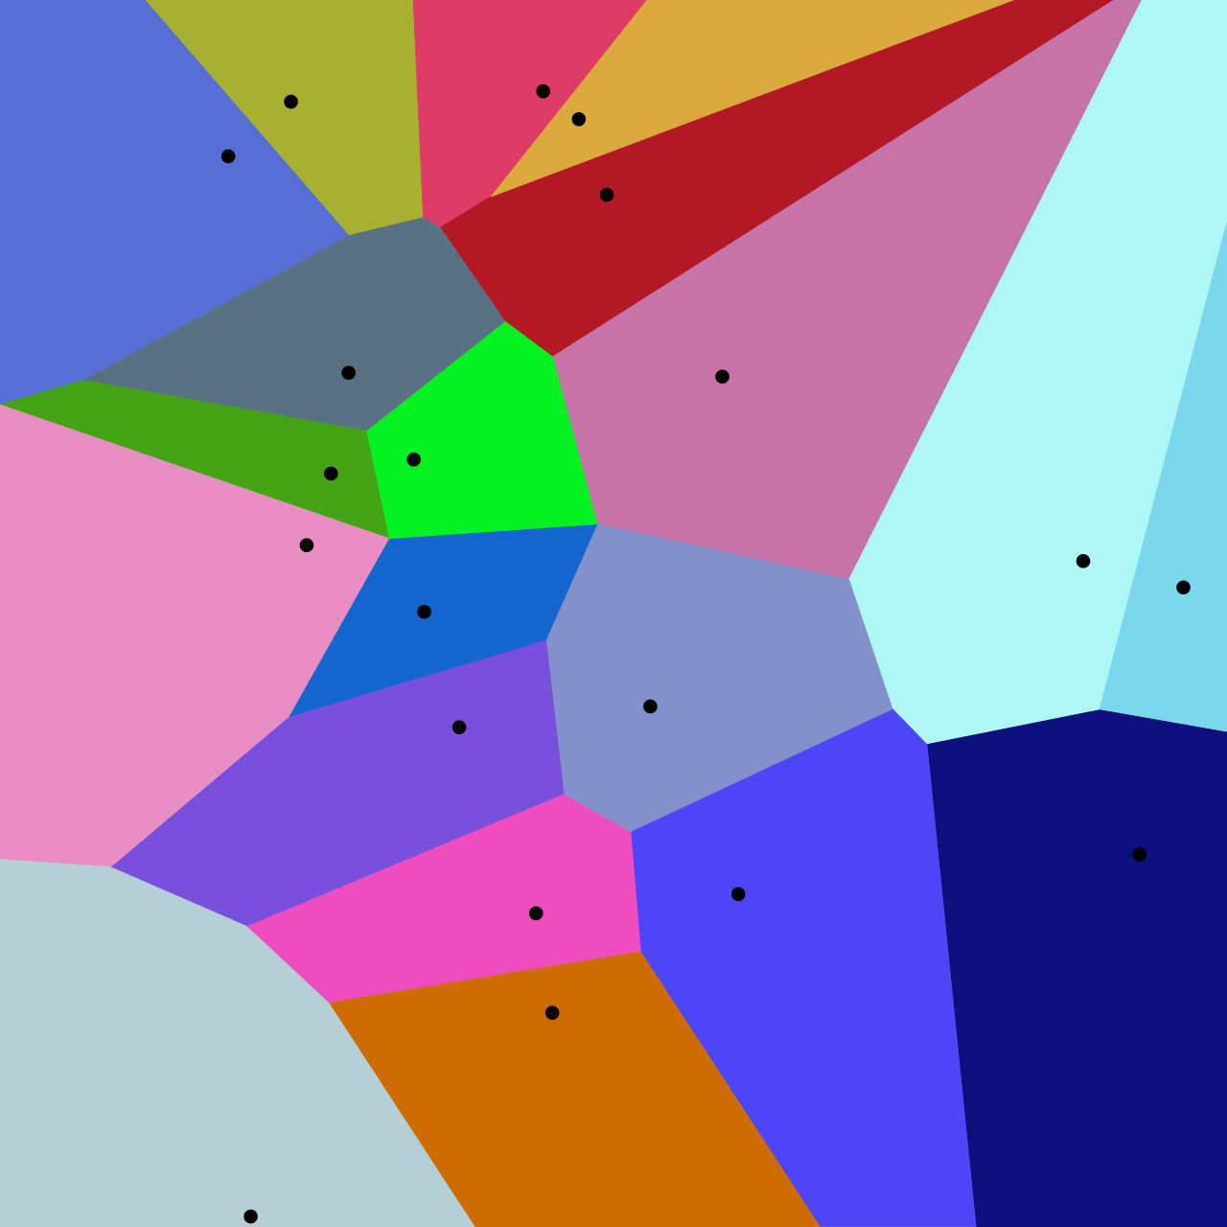
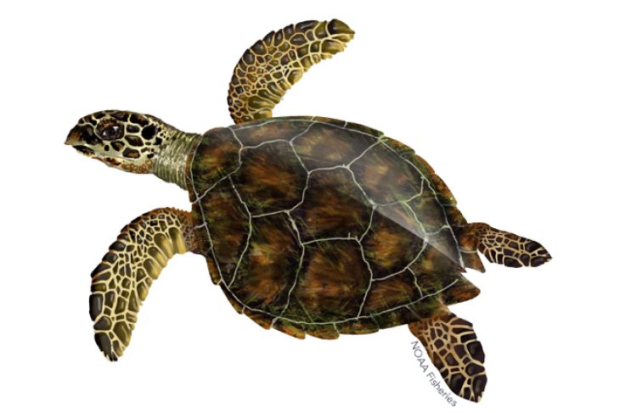
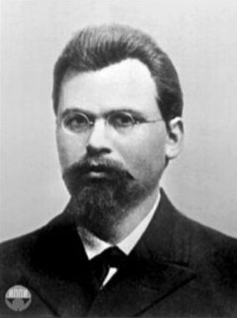
1. Background
What is the Voronoi Diagram?
Georgy Fedoseevich Voronoy (b.1868 - d.1908)
https://www.google.com/url?sa=i&url=https%3A%2F%2Fwww.fisheries.noaa.gov%2Fspecies%2Fhawksbill-turtle&psig=AOvVaw0owEyuYqAvjTKz4L5Ebt-P&ust=1635892909910000&source=images&cd=vfe&ved=0CAwQjhxqFwoTCICRtJCe-PMCFQAAAAAdAAAAABAL
https://www.google.com/url?sa=i&url=https%3A%2F%2Fwww.perkinselearning.org%2Faccessible-science%2Factivities%2Fmodeling-plant-cell&psig=AOvVaw2WGFQuAJAhkrUw0d7st6ty&ust=1635901136992000&source=images&cd=vfe&ved=0CAwQjhxqFwoTCOjKqOm8-PMCFQAAAAAdAAAAABAD
https://www.google.com/url?sa=i&url=https%3A%2F%2Fwww.pngwing.com%2Fen%2Ffree-png-zddrw&psig=AOvVaw1jyZA8lrU3pOjwFToilMz1&ust=1635900445269000&source=images&cd=vfe&ved=0CAwQjhxqFwoTCPD49Z26-PMCFQAAAAAdAAAAABAJ
https://towardsdatascience.com/how-to-find-the-nearest-hospital-with-voronoi-diagram-63bd6d0b7b75
https://www.google.com/url?sa=i&url=https%3A%2F%2Fwallpapersafari.com%2Fw%2FOUYkc7&psig=AOvVaw36ZofqZ7CcWlBq_STIGzQ5&ust=1635900729924000&source=images&cd=vfe&ved=0CAwQjhxqFwoTCPja66W7-PMCFQAAAAAdAAAAABAe
https://www.google.com/url?sa=i&url=https%3A%2F%2Fwww.pngwing.com%2Fen%2Ffree-png-bzjox&psig=AOvVaw1QupQCUbHjFVzq701Z99XP&ust=1635900045538000&source=images&cd=vfe&ved=0CAwQjhxqFwoTCLjU8t24-PMCFQAAAAAdAAAAABAD

Slide 4
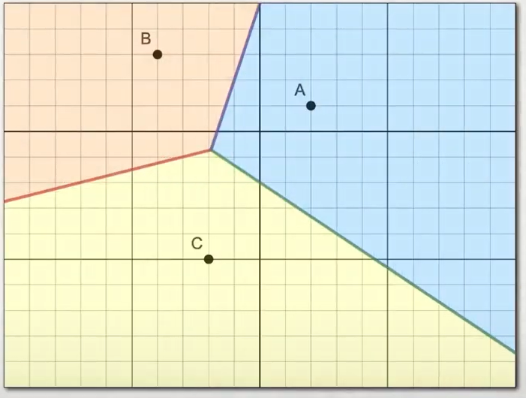
1. Background
Why is the Voronoi Diagram?
B
A
C
https://www.youtube.com/watch?v=1iYkEv6AxzU

Slide 5
1. Background
Why is the Voronoi Diagram?
Site of the diagram
B
Point on the edge
A
Point in the cell region
Vertex of the diagram
C
https://www.youtube.com/watch?v=1iYkEv6AxzU

Slide 6

1. Background
Why is the Voronoi Diagram?
After we have set the Sites in the region of the diagram canvas, the region of each Voronoi cell provides the optimized distance (the global shortest distance).
For point in its site’s region, it is more cost-efficient for the point to reach back to this site compared with heading for other cell’s sites.
https://en.wikipedia.org/wiki/Voronoi_diagram#:~:text=In%20mathematics%2C%20a%20Voronoi%20diagram,%2C%20sites%2C%20or%20generators).&text=Voronoi%20cells%20are%20also%20known%20as%20Thiessen%20polygons.
https://towardsdatascience.com/how-to-find-the-nearest-hospital-with-voronoi-diagram-63bd6d0b7b75

Slide 7
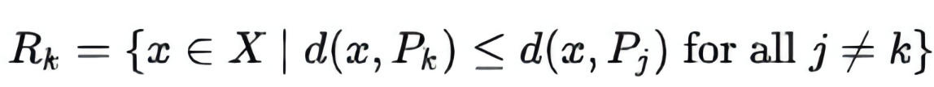
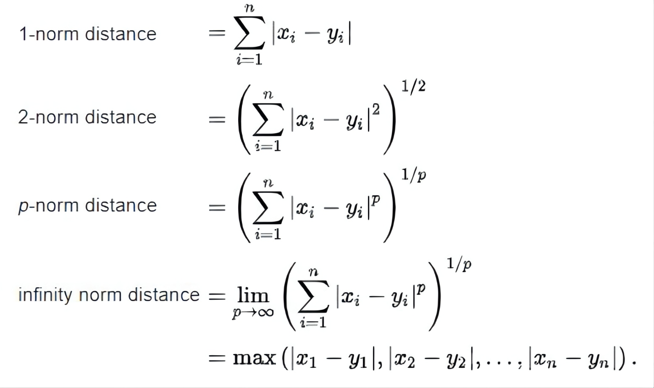
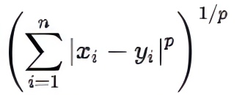
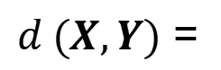
2. Introduction of the theory
What is the Voronoi Diagram in Math?
Minkowski distance of order p (p-norm distance)：
$d (X,Y)$ =
https://en.wikipedia.org/wiki/Voronoi_diagram#:~:text=In%20mathematics%2C%20a%20Voronoi%20diagram,%2C%20sites%2C%20or%20generators).&text=Voronoi%20cells%20are%20also%20known%20as%20Thiessen%20polygons.
https://en.wikipedia.org/wiki/Distance

Slide 8
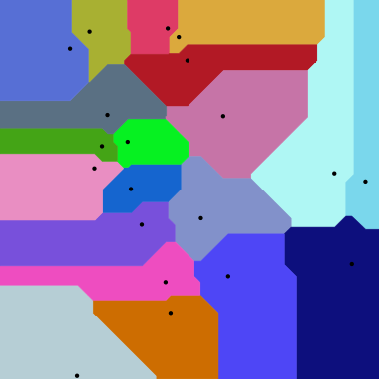
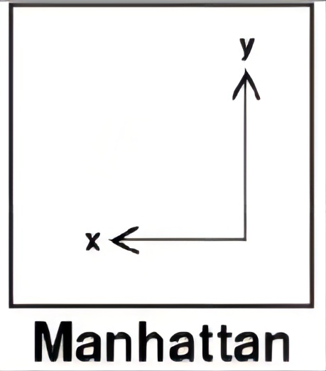
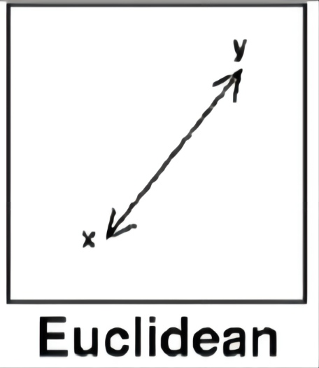
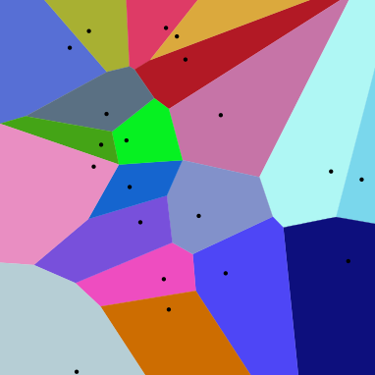
2. Introduction of the theory
What is the Voronoi Diagram in Math?
p = 1:
$d (X,Y)$ =
p = 2:
https://en.wikipedia.org/wiki/Voronoi_diagram#:~:text=In%20mathematics%2C%20a%20Voronoi%20diagram,%2C%20sites%2C%20or%20generators).&text=Voronoi%20cells%20are%20also%20known%20as%20Thiessen%20polygons.
https://en.wikipedia.org/wiki/Distance

Slide 9

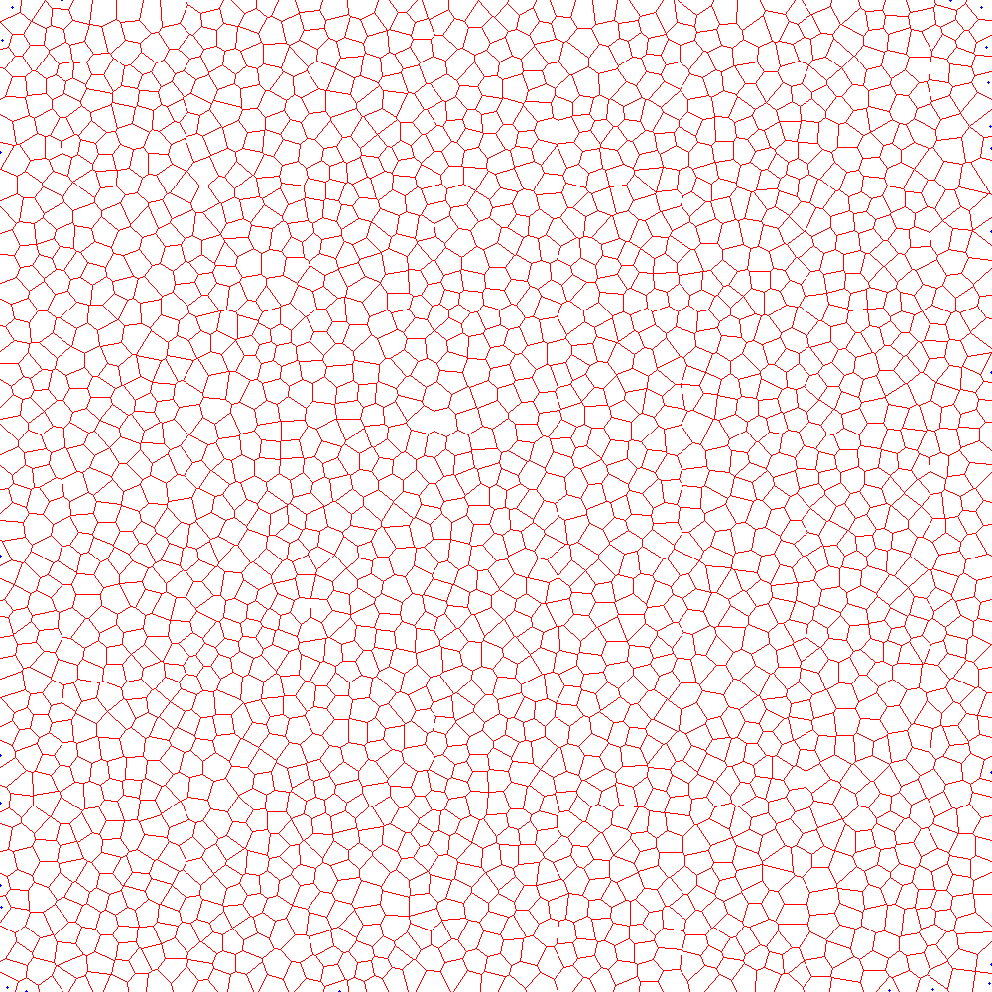
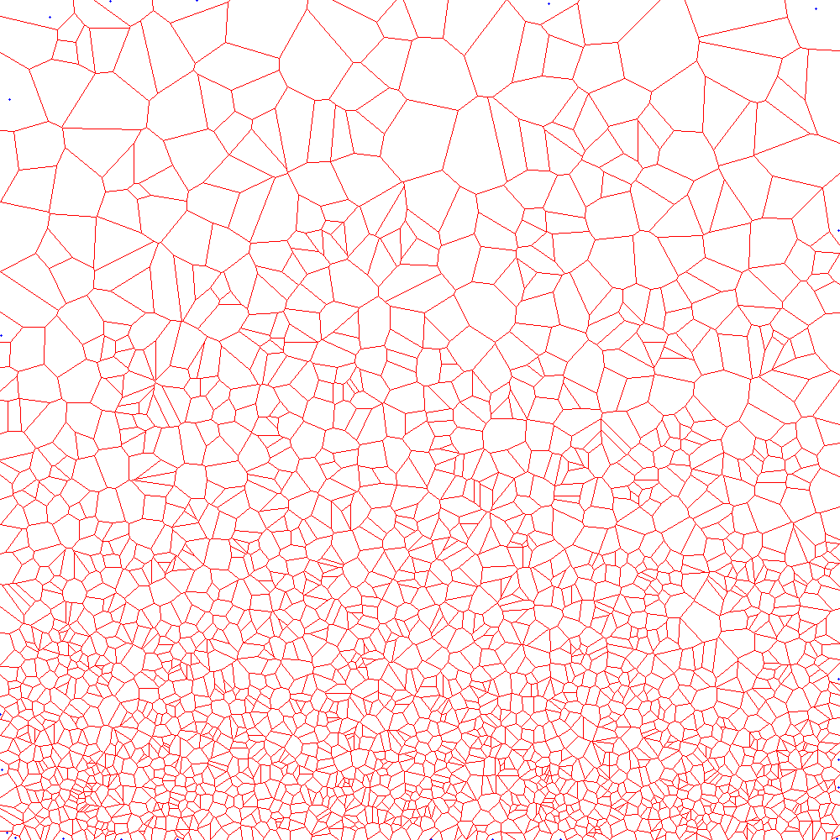
2. Introduction of the theory
What is the Voronoi Diagram in Math?
https://en.wikipedia.org/wiki/Voronoi_diagram#:~:text=In%20mathematics%2C%20a%20Voronoi%20diagram,%2C%20sites%2C%20or%20generators).&text=Voronoi%20cells%20are%20also%20known%20as%20Thiessen%20polygons.
https://en.wikipedia.org/wiki/Distance

Slide 10
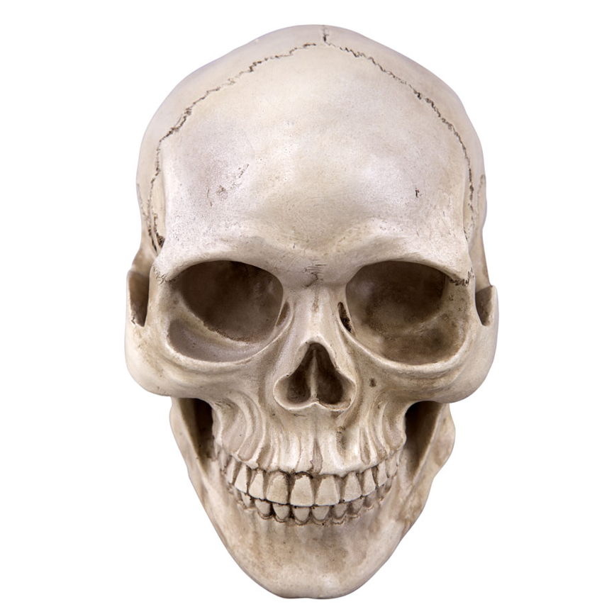
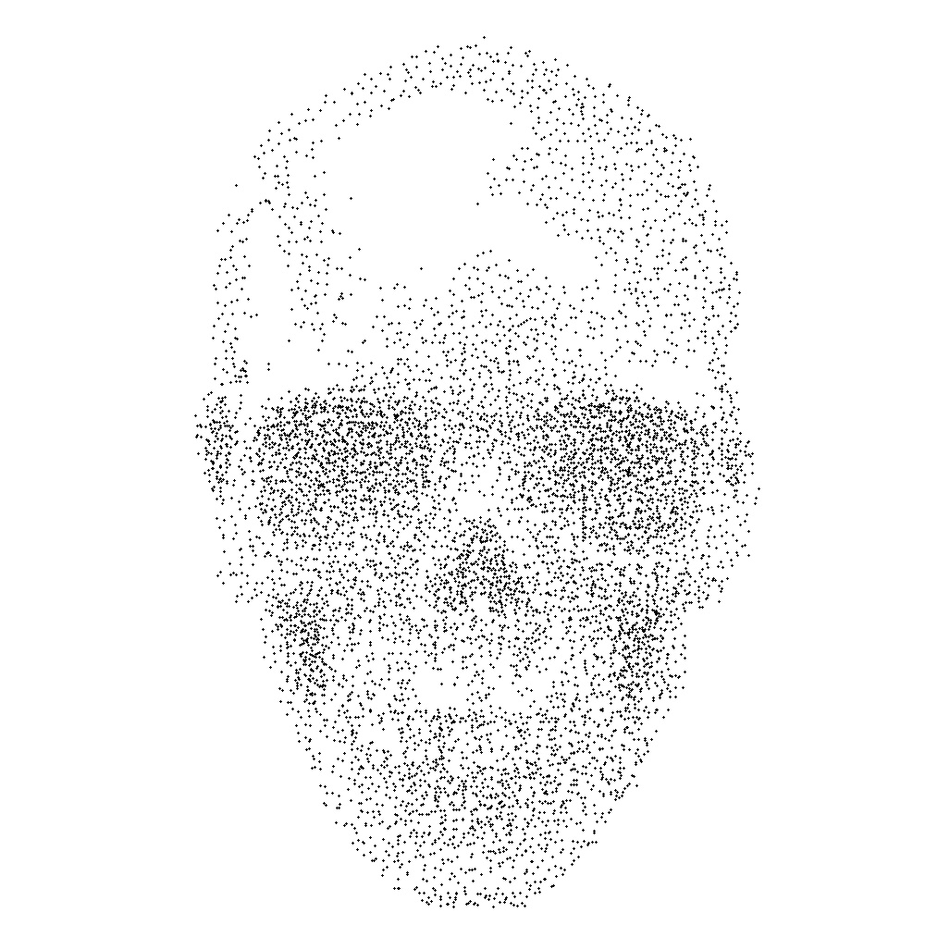
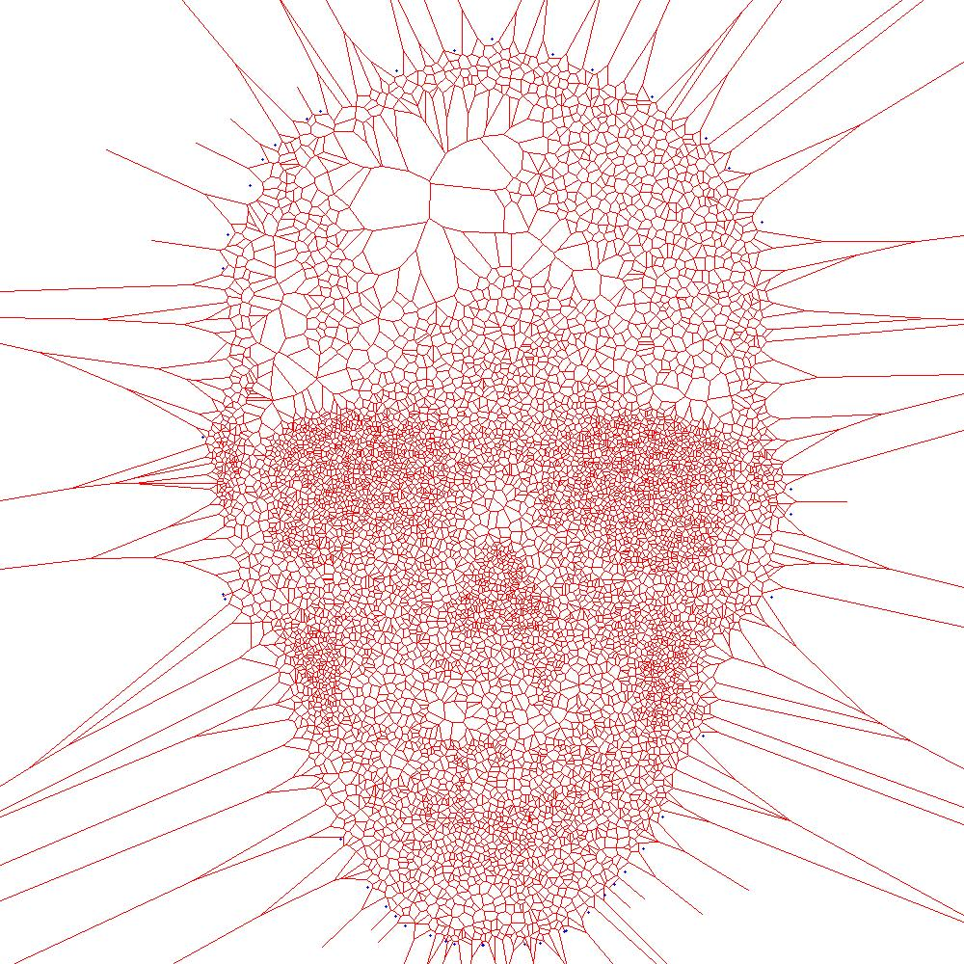
2. Introduction of the theory
What is the Voronoi Diagram in Math?
https://en.wikipedia.org/wiki/Voronoi_diagram#:~:text=In%20mathematics%2C%20a%20Voronoi%20diagram,%2C%20sites%2C%20or%20generators).&text=Voronoi%20cells%20are%20also%20known%20as%20Thiessen%20polygons.
https://en.wikipedia.org/wiki/Distance

Slide 11
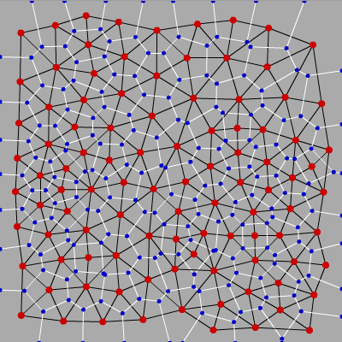
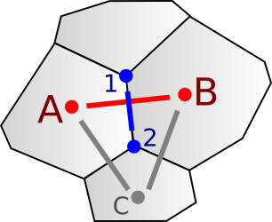
2. Introduction of the theory
What is the Voronoi Diagram in Math?
Dual graph: Delaunay triangulation
Vertical split to each other !!
http://www-cs-students.stanford.edu/~amitp/game-programming/polygon-map-generation/

Slide 12
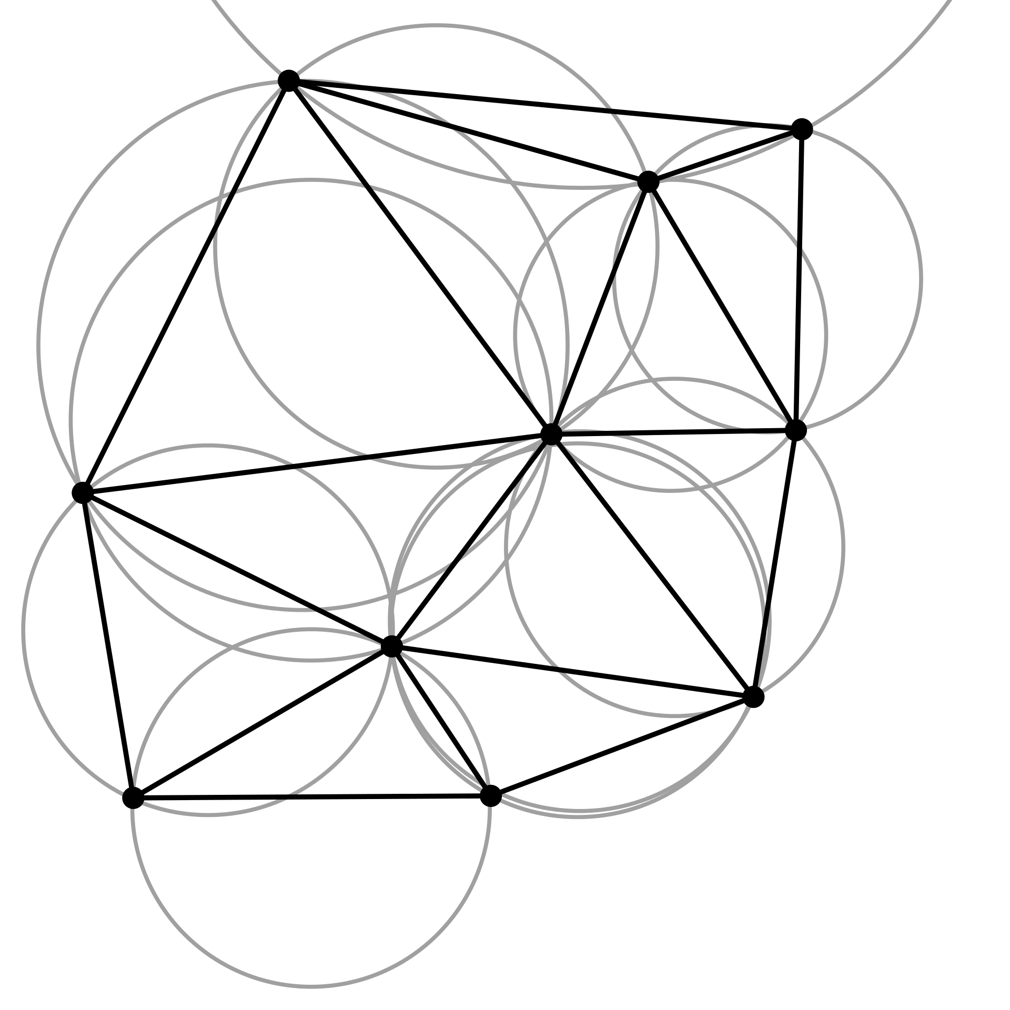
2. Introduction of the theory
What is the Voronoi Diagram in Math?
Dual graph: Delaunay triangulation
Vertical split to each other !!
http://www-cs-students.stanford.edu/~amitp/game-programming/polygon-map-generation/

Slide 13
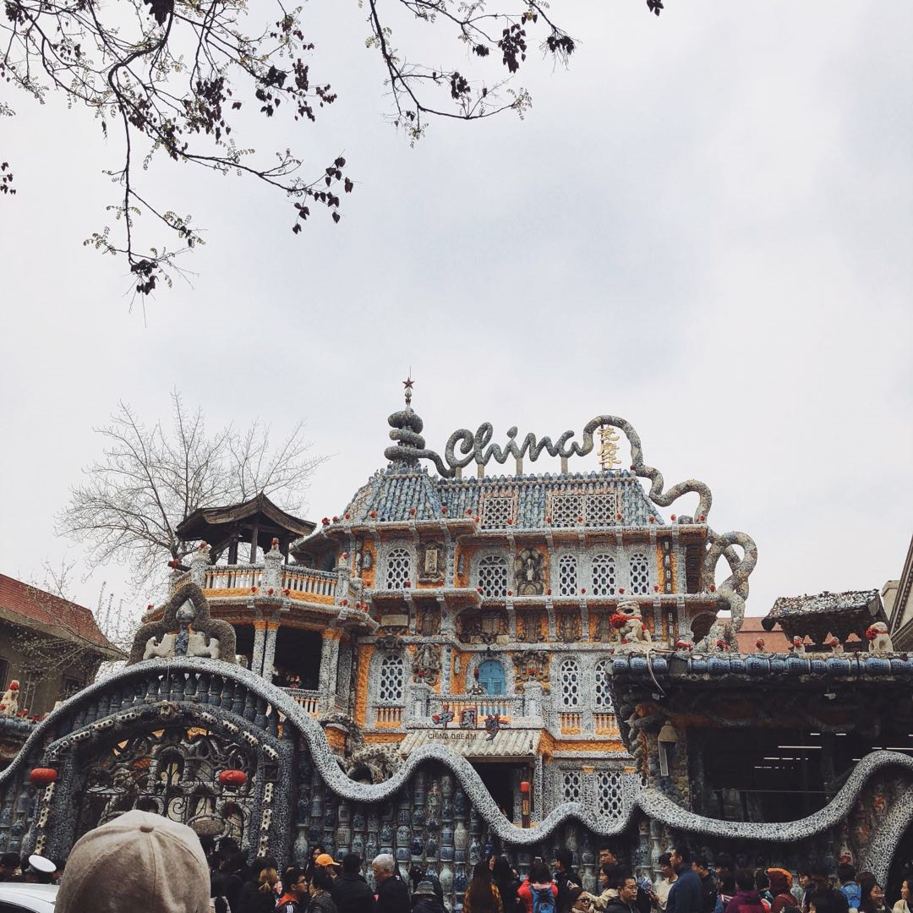
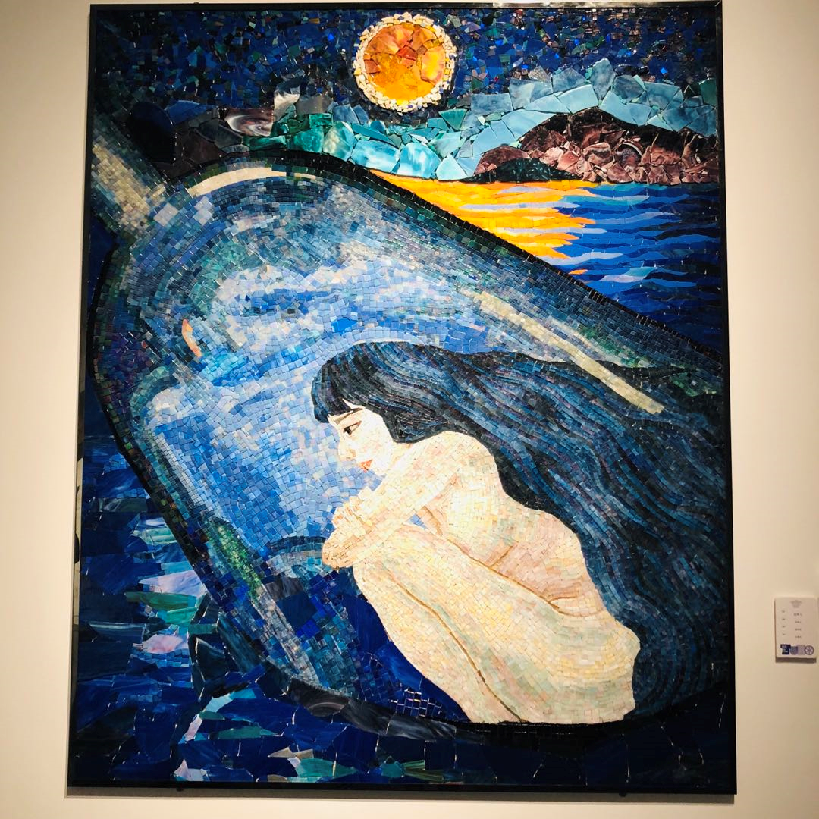

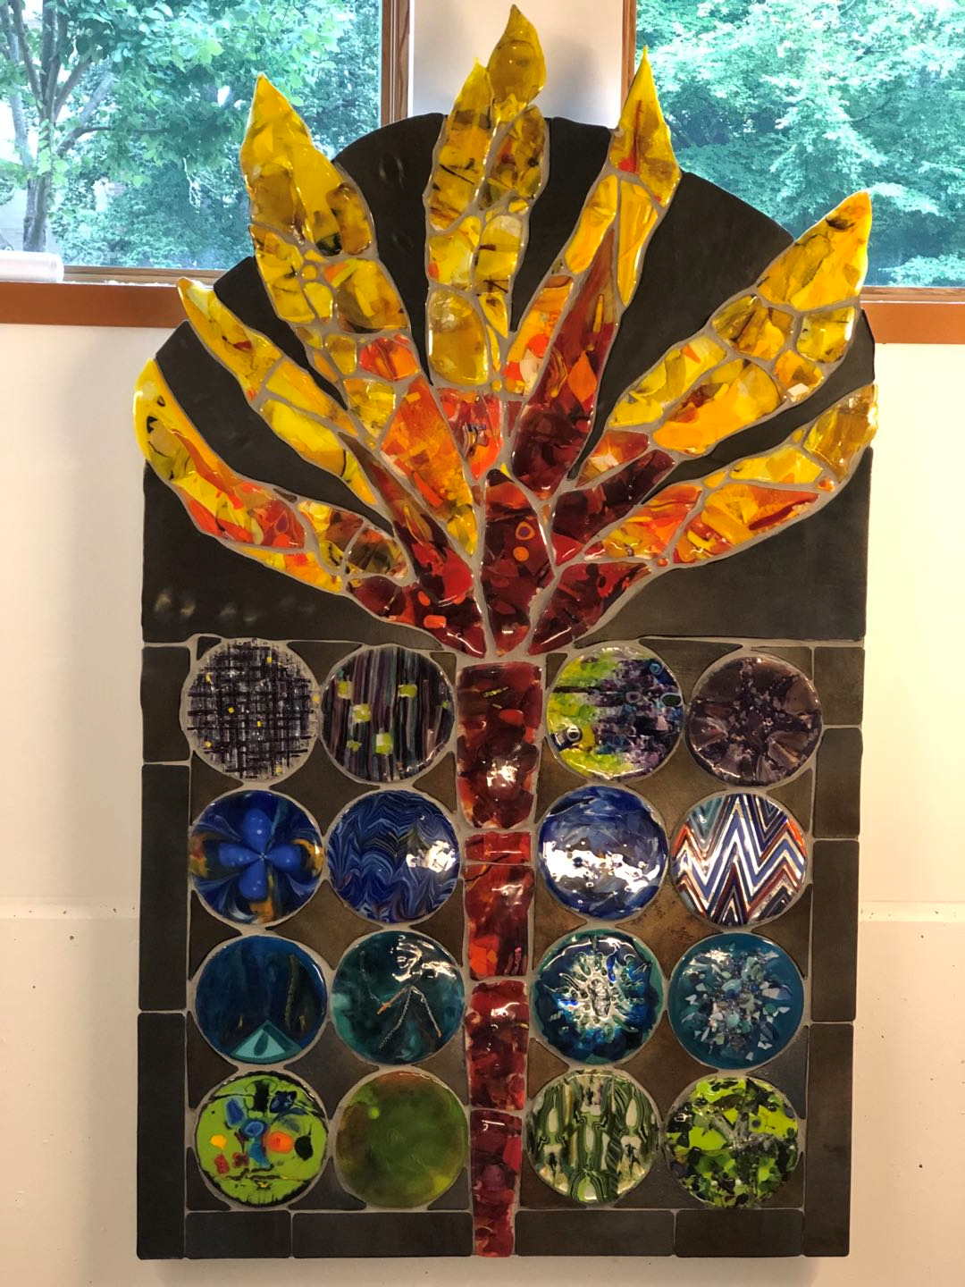
3. Mosaic method
The are lots of arts are made by Mosaic Tech:

Slide 14
3. Mosaic method
The are lots of arts are made by Mosaic Tech:
https://www.youtube.com/watch?v=DmmQIiMsVjg
https://mail.google.com/mail/u/0/#inbox/FMfcgzGlkjZJXCMcQgRPcnFHDrDbNKlg?projector=1

Slide 15


3. Mosaic method
Let’s talk about an automatic method for mosaicing images by using Voronoi diagrams.
http://dx.doi.org/10.2312/egs.20021036

Slide 16
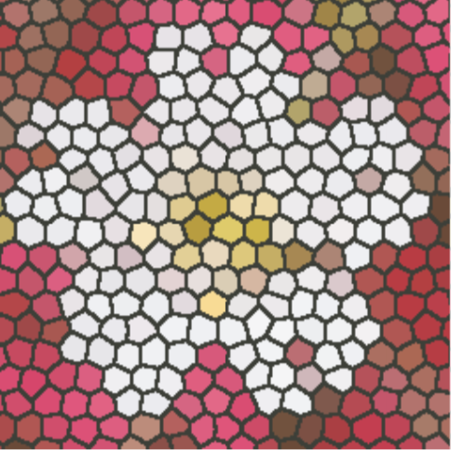
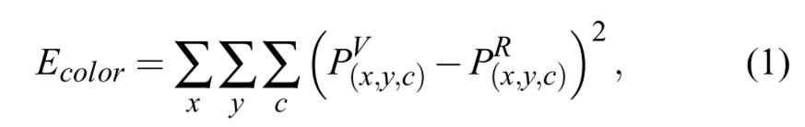
3. Mosaic method
Let’s talk about an automatic method for mosaicing images by using Voronoi diagrams.
Reference image (R)
Voronoi image (V)
Pixel position (x, y)
Pixel color (R, G, B)
http://dx.doi.org/10.2312/egs.20021036

Slide 17

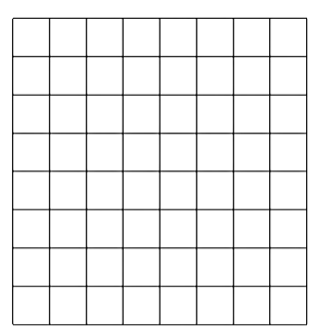
3. Mosaic method
Let’s talk about an automatic method for mosaicing images by using Voronoi diagrams.
1. Assume that the site of a Voronoi diagram is located at the center of a pixel.
2. The color of that Voronoi region refers the color of that pixel in the image R.
Reference image (R)
Voronoi image (V)
http://dx.doi.org/10.2312/egs.20021036

Slide 18
3. Mosaic method
Let’s talk about an automatic method for mosaicing images by using Voronoi diagrams.
The whole method can be divided into 2 steps:
I. Pattern Generation
1.1 Initial Positions of the Sites
1.2 Capturing the Global Features of the Reference Image
1.3 Local Adjustment of the Voronoi Image
1.4 Expression of Detailed Features
II. Effects Addition
2.1 Edge Highlight
2.2 Light Effect
http://dx.doi.org/10.2312/egs.20021036

Slide 19
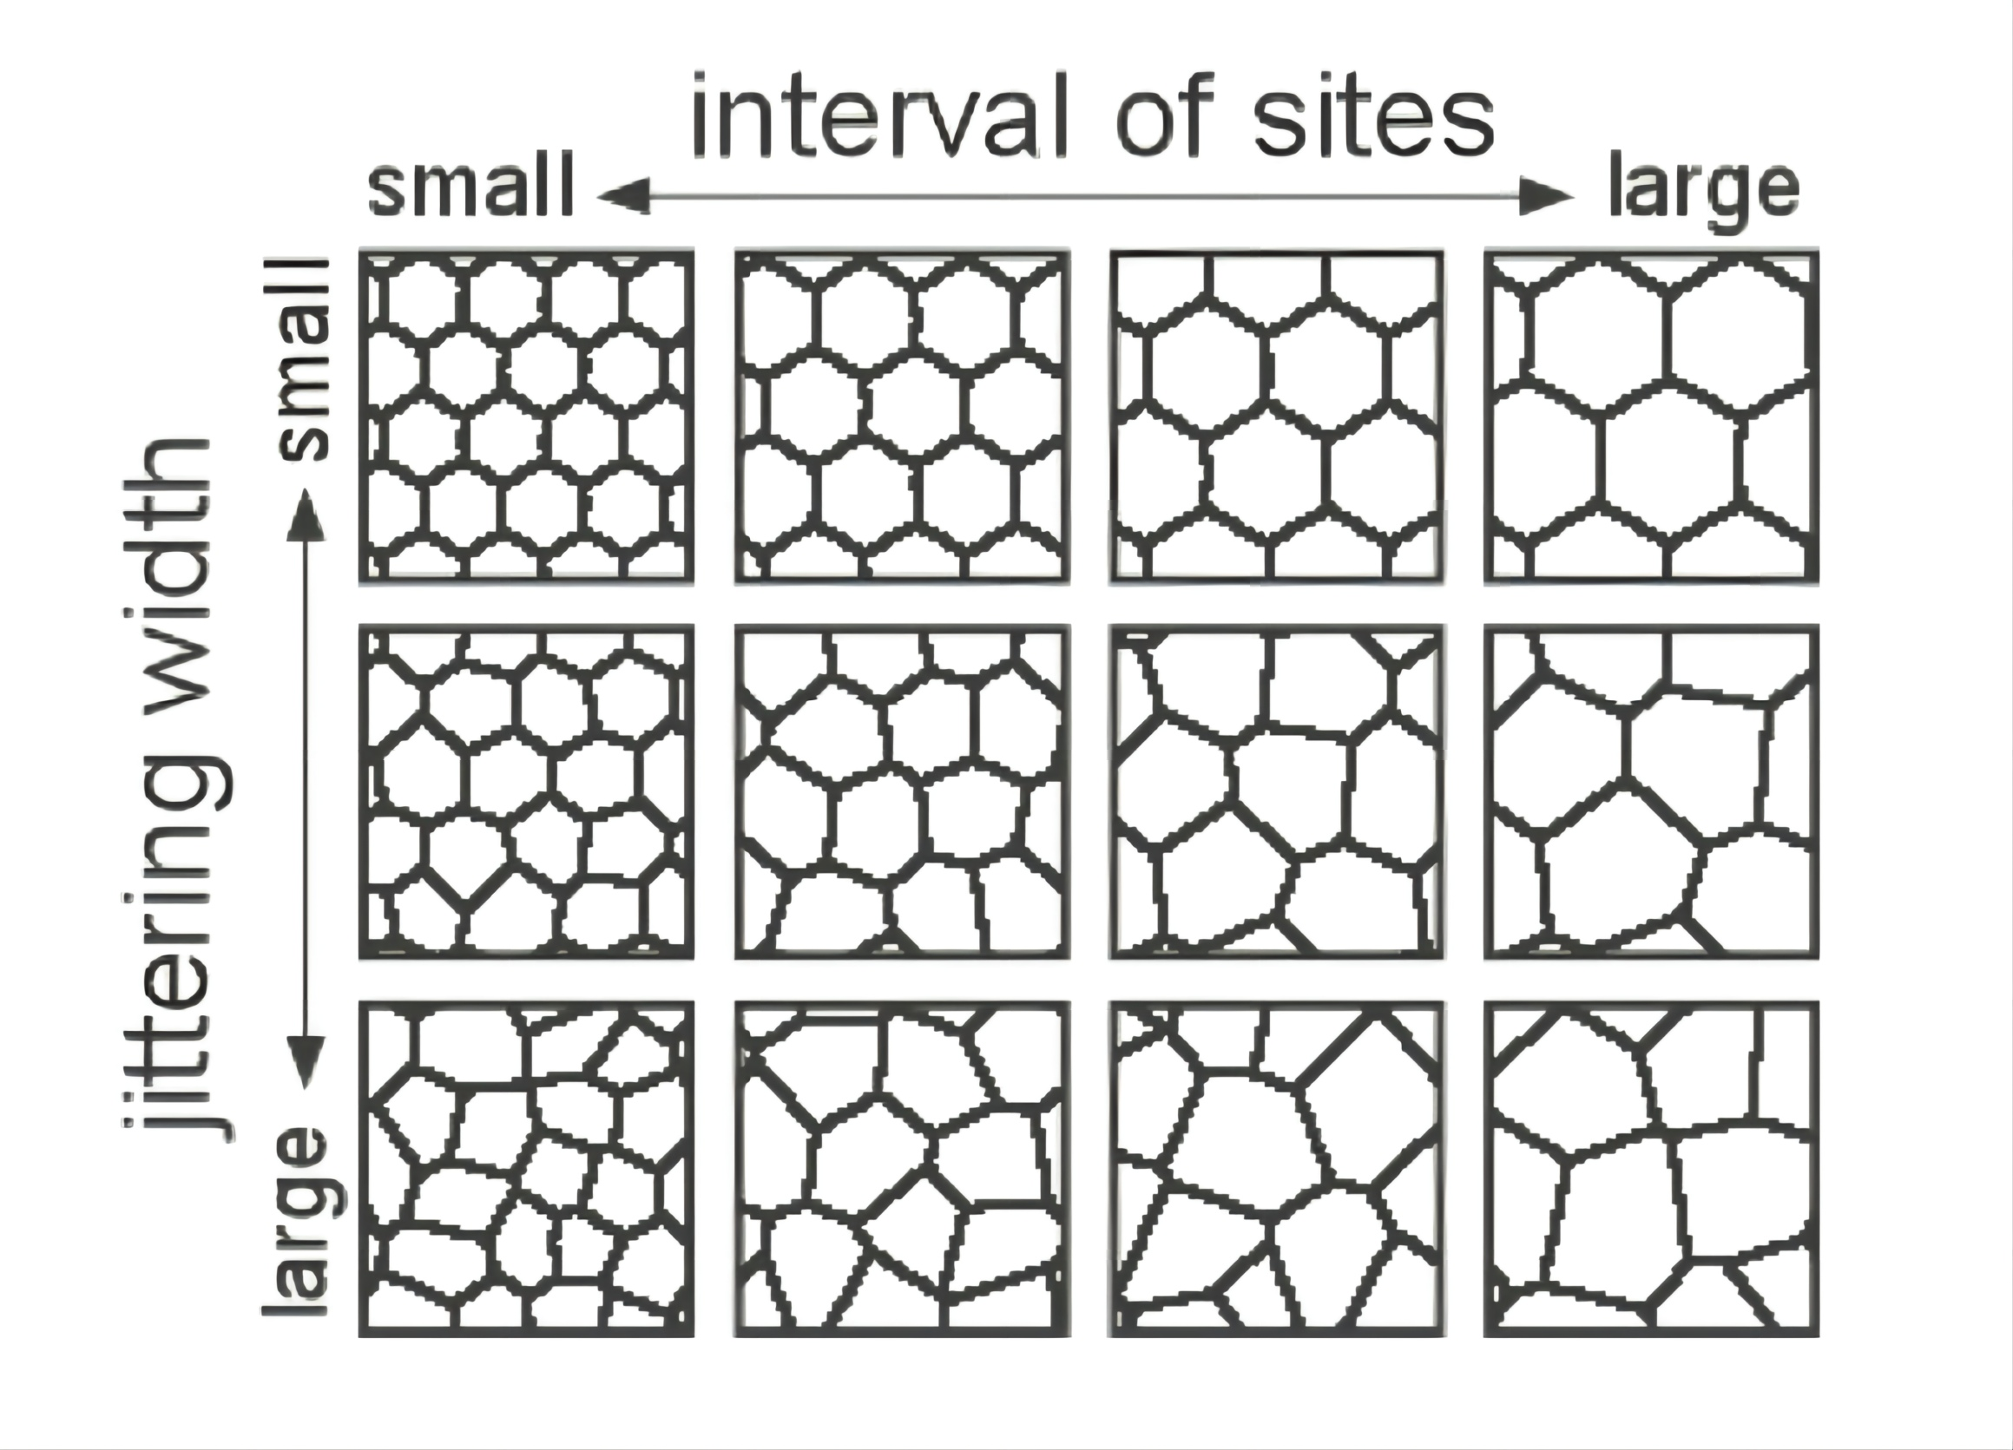











3. Mosaic method
1.1 Initial Positions of the Sites
The initial Voronoi image is created by placing its sites on the center of hexagonal lattices.
https://www.google.com/url?sa=i&url=https%3A%2F%2Fwww.pngwing.com%2Fen%2Ffree-png-zddrw&psig=AOvVaw1jyZA8lrU3pOjwFToilMz1&ust=1635900 44526 9000 &s ource=images &cd=vfe&ved=0CAwQjhxqFwoTCPD49Z26-PMCFQ AAAA AdAAAAAB A J
Then user can adjust:
1. the expected interval between sites;
2. the expected jittering width from the hexagonal lattices center.
http://dx.doi.org/10.2312/egs.20021036

Slide 20
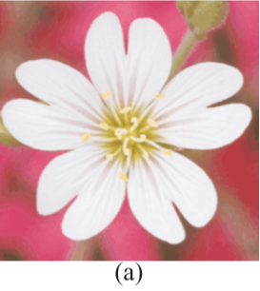
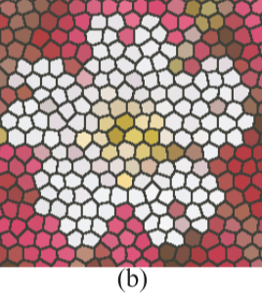
3. Mosaic method
1.1 Initial Positions of the Sites
http://dx.doi.org/10.2312/egs.20021036

Slide 21
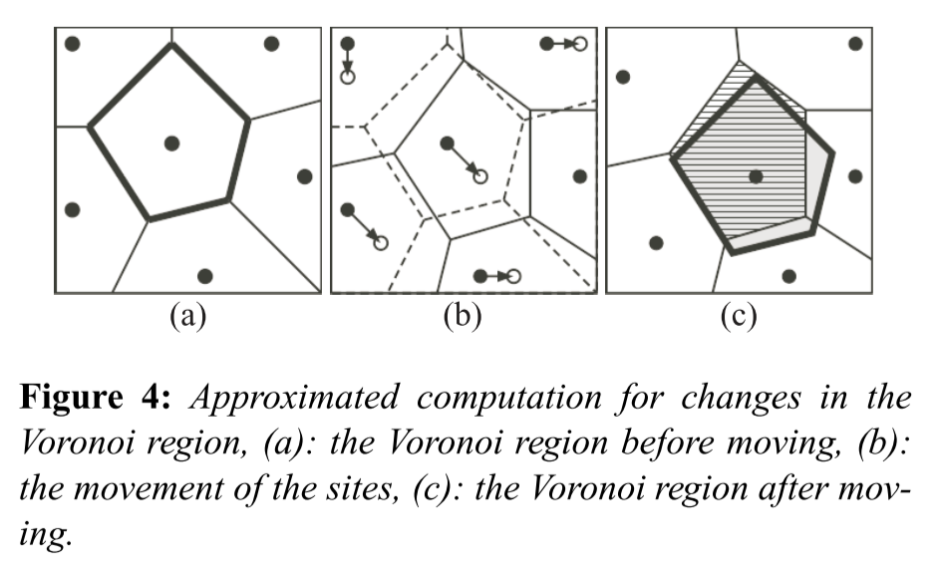
3. Mosaic method
1.2 Capturing the Global Features of the Reference Image
The shape of a Voronoi region (bold line region)
is determined by the relative position between its site and the sites of the surrounding Voronoi regions
http://dx.doi.org/10.2312/egs.20021036

Slide 22
3. Mosaic method
1.2 Capturing the Global Features of the Reference Image
A Voronoi image that expresses the global features of the reference image can be obtained by move all sites together iteratively until an end condition is triggered.
http://dx.doi.org/10.2312/egs.20021036

Slide 23
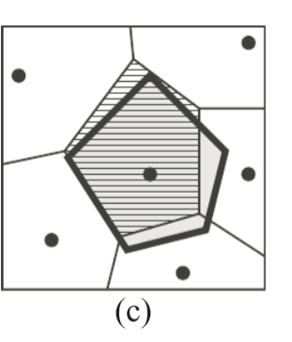
3. Mosaic method
1.2 Capturing the Global Features of the Reference Image
To simplify the computation, here we assume that the shape of each voronoi region will not change after the global movement.
Also when a site is moved, the color in it’s region will not change
http://dx.doi.org/10.2312/egs.20021036

Slide 24
3. Mosaic method
1.2 Capturing the Global Features of the Reference Image
So what is the end condition?
Thus we need to find a global movement of all sites in a direction where E_{color} decreases the most
<=> Finding the lowest value of the Error function E
http://dx.doi.org/10.2312/egs.20021036

Slide 25
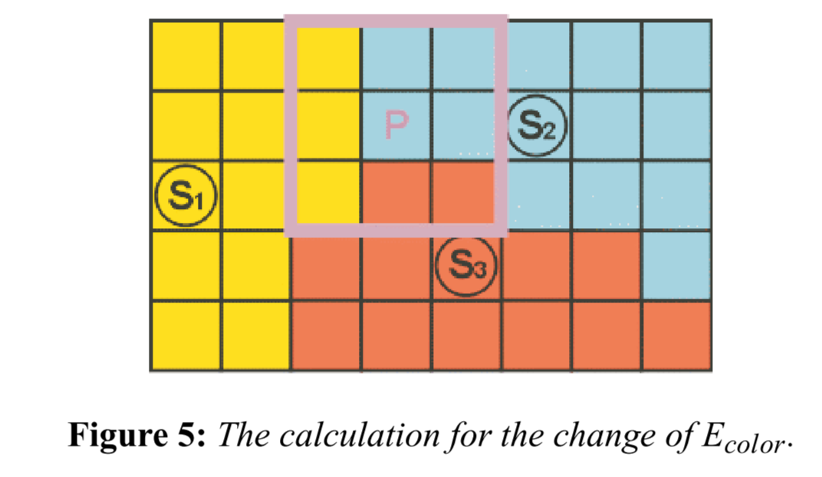

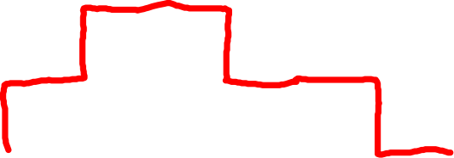

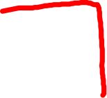



3. Mosaic method
1.2 Capturing the Global Features of the Reference Image
So what is the activity of each iteration?
In each iteration, each site’s movement traversing will be limited to its adjoining eight pixels.
Hence the site will be not moved if the eight-pixel-movement does not decrease the value of E_{color}.
http://dx.doi.org/10.2312/egs.20021036

Slide 26



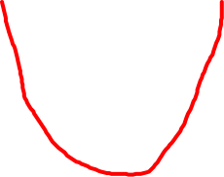
3. Mosaic method
1.2 Capturing the Global Features of the Reference Image
While E_{color} > ε:
For S in Sites:
For D in 8 neighbors’ direction:
Move Site to the neighbors’ position
E_{color}^{now} = Min (E_{color}^{old}, E_{color}^{D})
* Set threshold ε is because the location of the sites might not converge
http://dx.doi.org/10.2312/egs.20021036

Slide 27
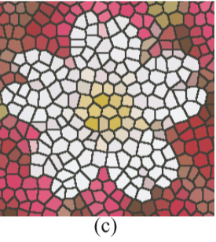
3. Mosaic method
1.2 Capturing the Global Features of the Reference Image
http://dx.doi.org/10.2312/egs.20021036

Slide 28
3. Mosaic method
1.3 Local Adjustment of the Voronoi Image
Unlike the global feature adjustment we talked before, in this Local Adjustment Voronoi sites are moved one at a time to adjust the local appearance of the Voronoi image.
For S in Sites:
For D in 8 neighbors’ direction:
E_{color}^{now} = Min (E_{color}^{old}, E_{color}^{D})
http://dx.doi.org/10.2312/egs.20021036

Slide 29
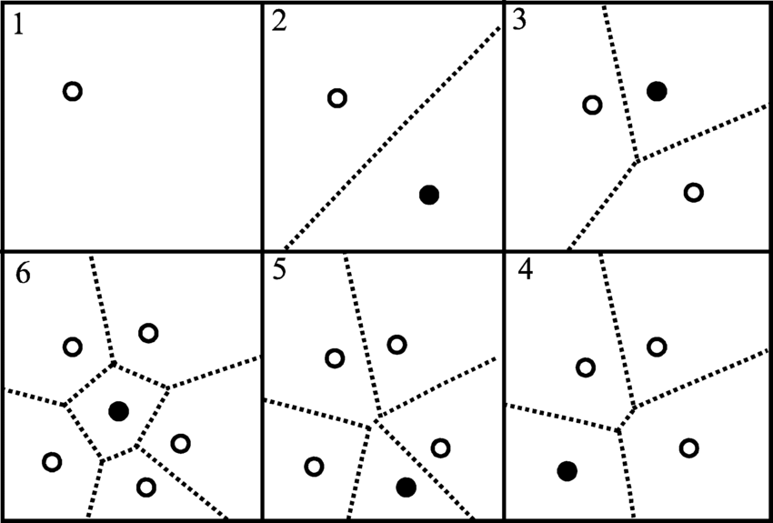
3. Mosaic method
1.4 Expression of Detailed Features
By adding or deleting the sites according to the need of the details.
https://www.google.com/url?sa=i&url=https%3A%2F%2Fwww.researchgate.net%2Ffigure%2FConstruction-of-a-Voronoi-diagram-using-successive-addition-of-sites-and-local_fig3_13908260&psig=AOvVaw0azSjO9bSpWP1WNIQBS5V6&ust=1635978173795000&source=images&cd=vfe&ved=0CAwQjhxqFwoTCPjL5Yfc-vMCFQAAAAAdAAAAABAD
http://dx.doi.org/10.2312/egs.20021036

Slide 30
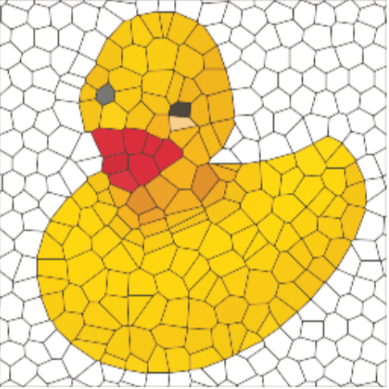
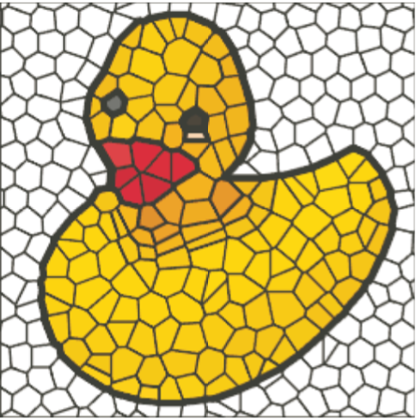
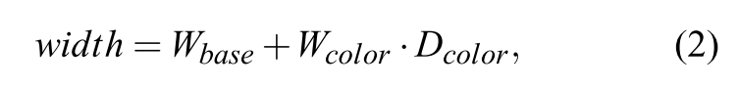




3. Mosaic method
2.1 Edge Highlighting
Original Black
Added Black
Color difference on edge
http://dx.doi.org/10.2312/egs.20021036

Slide 31
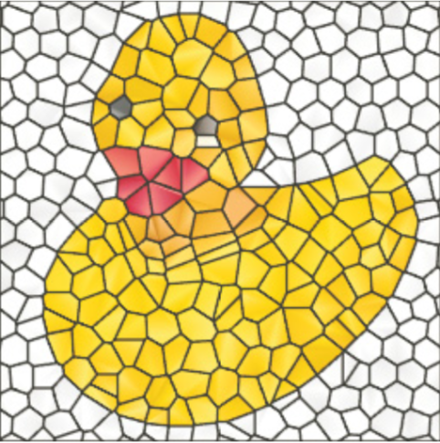
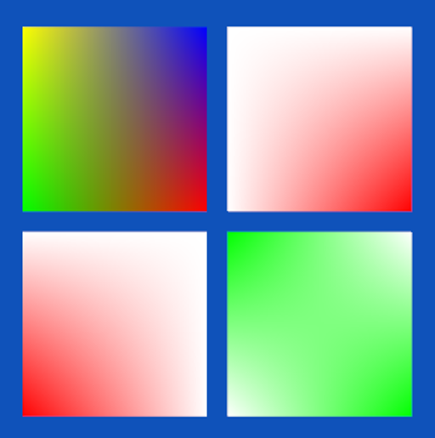
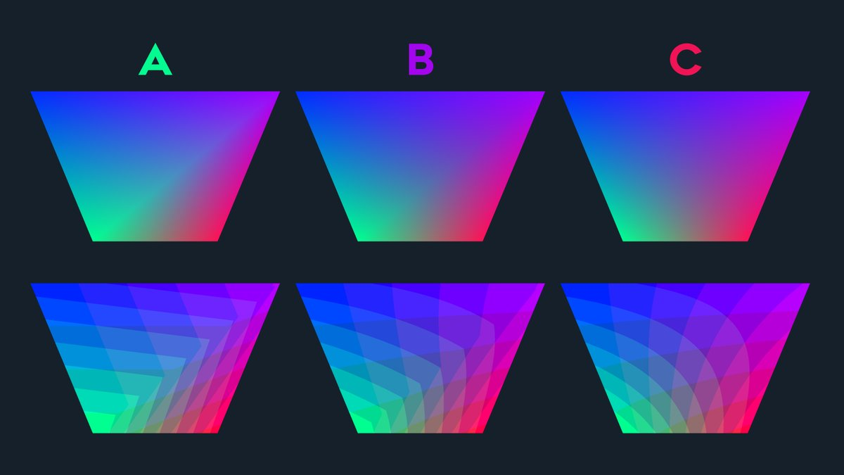
3. Mosaic method
2.2 Light Effect
https://www.google.com/url?sa=i&url=https%3A%2F%2Fasawicki.info%2Fnews_1721_how_to_correctly_interpolate_vertex_attributes_on_a_parallelogram_using_modern_gpus&psig=AOvVaw0x_bVKJkS6JBNgSed9WeHa&ust=1635979063975000&source=images&cd=vfe&ved=0CAwQjhxqFwoTCPjH0L3f-vMCFQAAAAAdAAAAABAD
https://www.google.com/url?sa=i&url=https%3A%2F%2Ftwitter.com%2Ffreyaholmer%2Fstatus%2F1243602929304600578&psig=AOvVaw3tpssUNwIr48cqOQo3q8Fo&ust=1635979114063000&source=images&cd=vfe&ved=0CAwQjhxqFwoTCOiit6Xf-vMCFQAAAAAdAAAAABAD
http://dx.doi.org/10.2312/egs.20021036

Slide 32
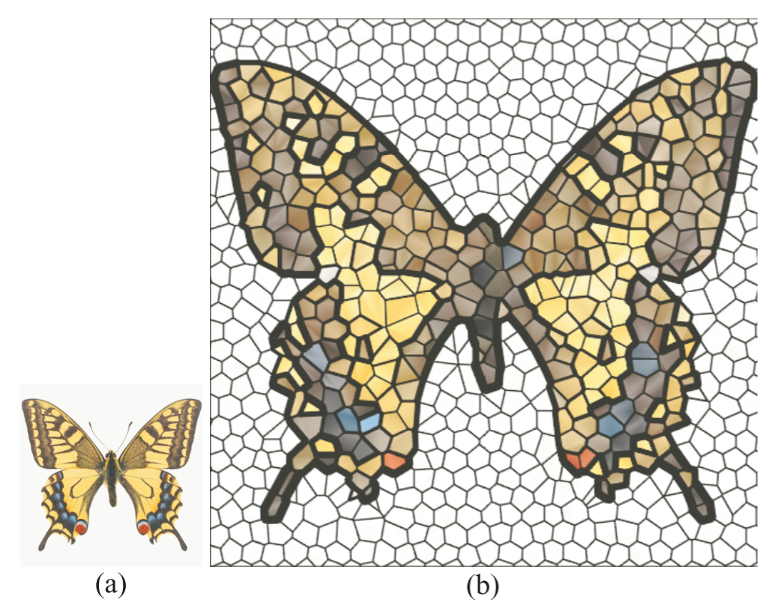
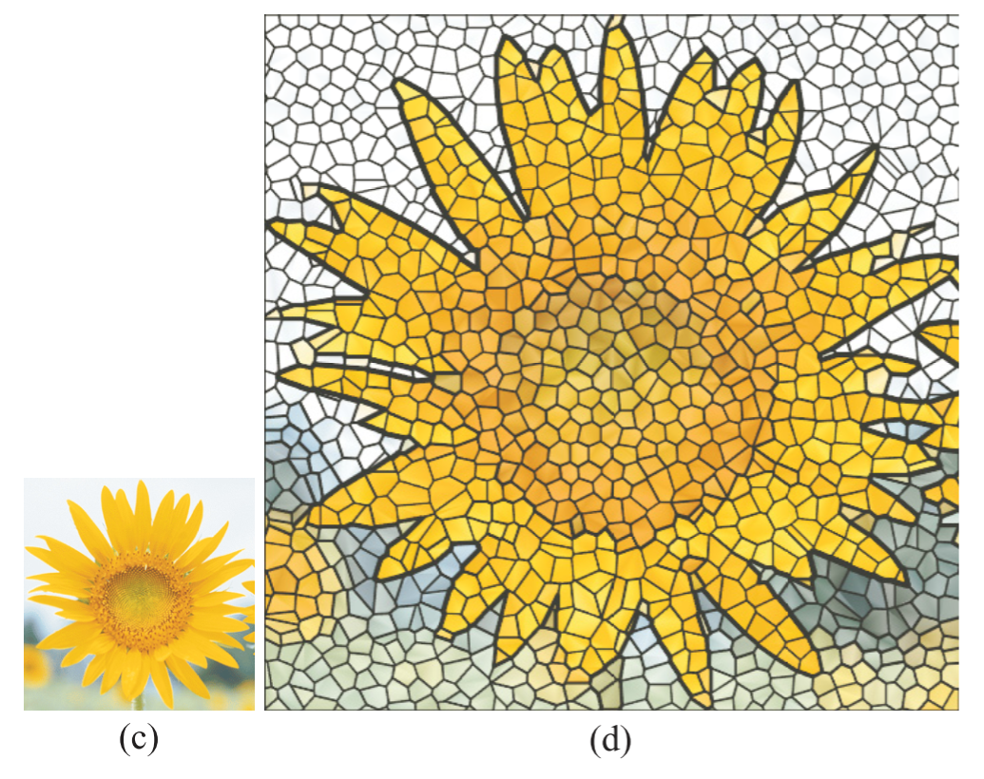
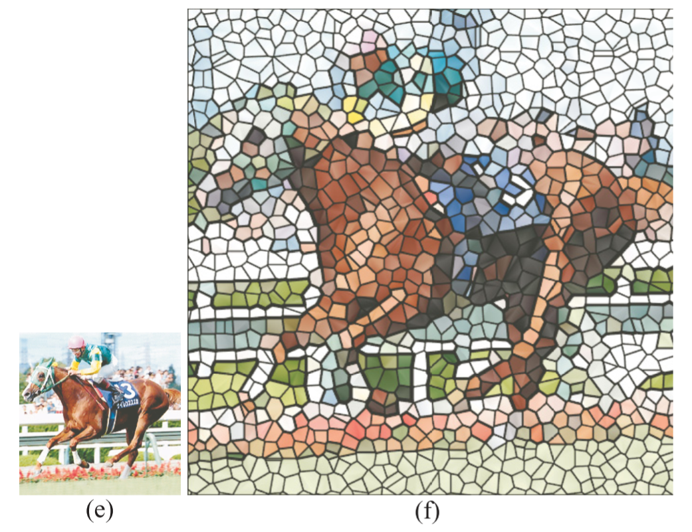
3. Mosaic method
Some of the result
http://dx.doi.org/10.2312/egs.20021036

